Slide 1
Human Computer Interaction
The Interaction
Chapter 3b
Imran Siddiqi
imran.siddiqi@mcs.edu.pk

Slide 2
Contents
Introduction
Models of Interaction
Ergonomics
Interaction Styles
Interactivity
Experience, Engagement & Fun
The Interaction

Slide 3
Interaction Styles
The Interaction

Slide 4
Common Interaction Styles
Command line interface
Menus
Natural language
Form-fills and spreadsheets
WIMP
Point and click
Three–dimensional interfaces
The Interaction

Slide 5
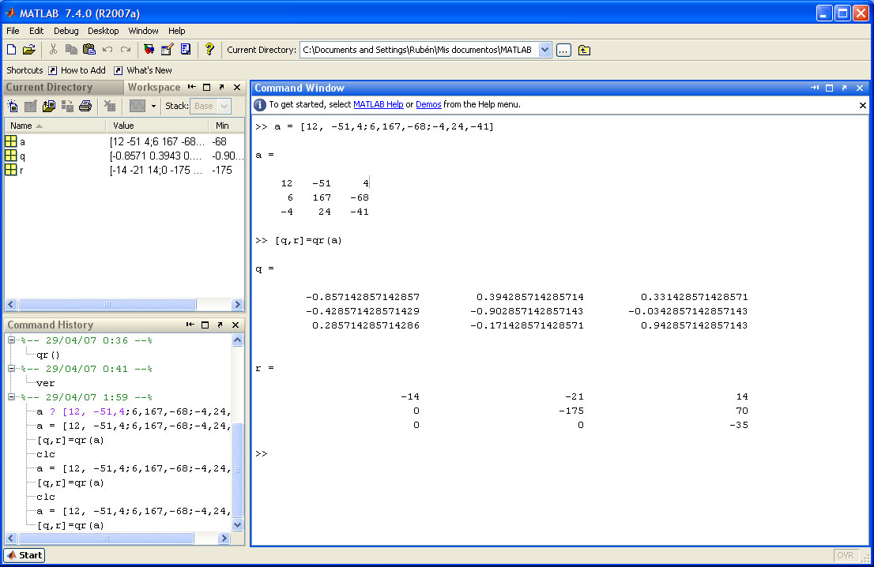
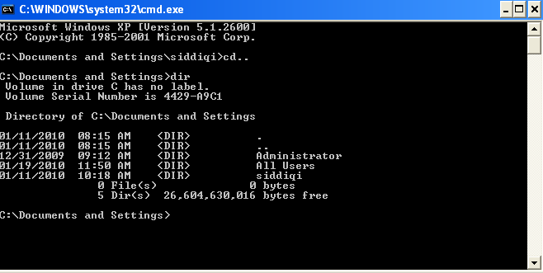
Command Line Interface
The Interaction

Slide 6
Command Line Interface
Way of expressing instructions to the computer directly
Function keys, single characters, short abbreviations, whole words, or a combination
Powerful – Offers direct access to system functionality
Better for expert users than novices
Command names/abbreviations should be meaningful!
The Interaction

Slide 7
Menus
Set of options displayed on the screen
Options visible
  Rely on recognition rather than recall
  Easier to use
Names should be meaningful
Selection by:
  numbers, alphabets, arrow keys, mouse
Menus
  Purely Text
  May have a Graphical Component
Restricted form of full WIMP system
The Interaction

Slide 8
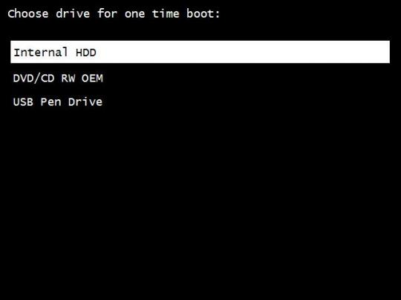
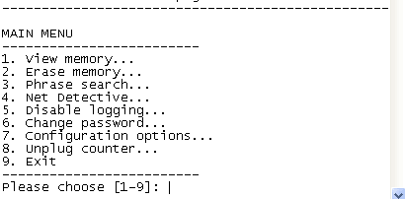
Menus
The Interaction

Slide 9
Natural Language
Familiar to user
Speech recognition or typed natural language
Problems
  Ambiguity at Phrase Level
    The boy hit the dog with the stick
  Ambiguity of Individual words
    Synonyms, Pronouns
General natural language interface – Unlikely
Restricted domain – Known Vocabulary
The Interaction

Slide 10
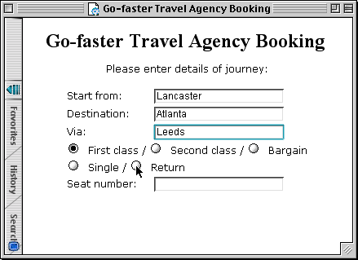
Form-Fills
Primarily for data entry or data retrieval
Screen like paper form
Easy to Use
Generally allow
  Blank Fields
  Correction Facilities
The Interaction

Slide 11

Spread Sheets
Sophisticated variation of form-filling
Grid of cells contain a value or a formula
Formula can involve values of other cells
  E.g. sum of all cells in this column
User can enter and alter data - spreadsheet maintains consistency
MS Excel – Most common spread sheet today
The Interaction

Slide 12
WIMP Interface
Windows, Icons, Menu, Pointers
Or Windows, Icons, Mice, and Pull-down menus
Default style for majority of interactive computer systems, especially desktop machines
  Windows, MAC
The Interaction

Slide 13
Point and Click Interfaces
Commonly Used in ..
  Web browsers
  Hypertext
Just click something!
  Icons, text links or location on map
Minimal typing
Web is a typical point and click interface
Closely related to WIMP
The Interaction

Slide 14


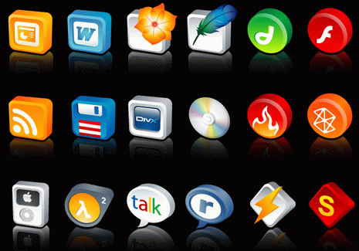
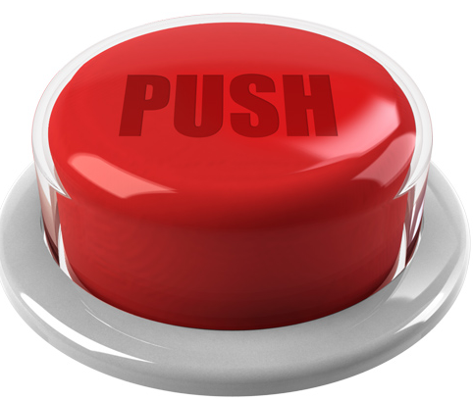
Three Dimensional Interfaces
Virtual Reality Interfaces
Ordinary WIMP elements: 3D Appearance
  Shading
  Sculptured
flat buttons …
… or sculptured
The Interaction

Slide 15
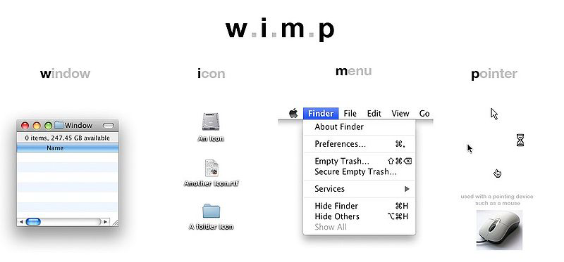
Elements of the WIMP Interface
Windows, icons, menus, pointers
Buttons, toolbars, dialog boxes
The Interaction

Slide 16
Windows
Areas of the screen that behave as if they were independent
  Can contain text or graphics
  Can be moved or resized
  Can overlap and obscure each other, or can be laid out next to one another (tiled)
Scrollbars
  Allow the user to move the contents of the window up and down or from side to side
Title bars
  Describe the name of the window
The Interaction

Slide 17
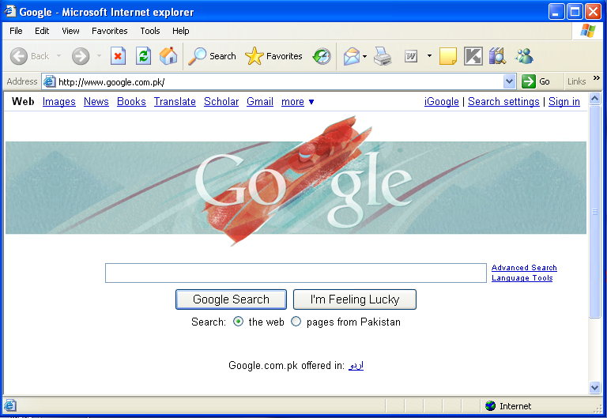
Windows
Title Bar
Menu Bar
Scroll Bar
The Interaction

Slide 18
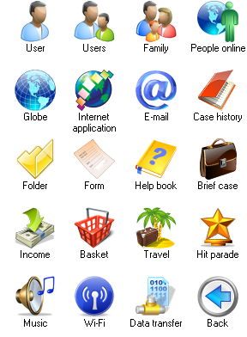
Icons
Small picture or image
Represents some object in the interface
  Often a window or action
Icons can take many forms
  Highly stylized
  Realistic representations
The Interaction

Slide 19
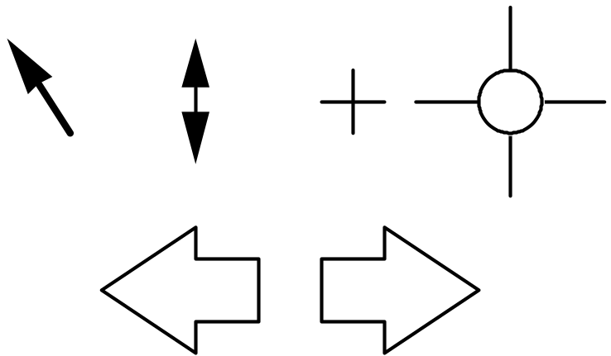
Pointers
Important component
  WIMP style relies on pointing and selecting things
Uses mouse, trackpad, joystick, trackball, cursor keys or keyboard shortcuts
Wide variety of Pointer Cursors
Cursor Hot-spot
  The location to which it points
The Interaction

Slide 20
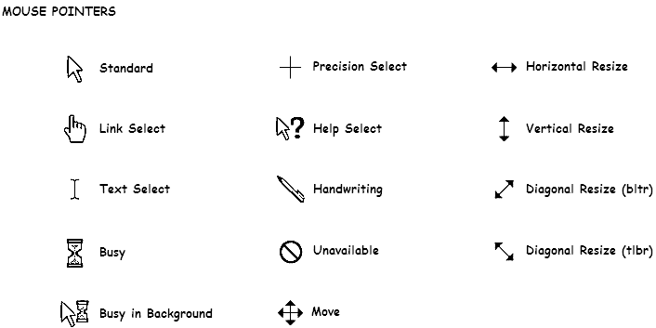
Pointers
The Interaction

Slide 21
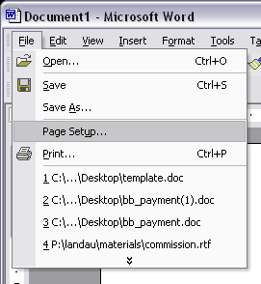
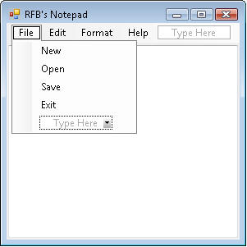
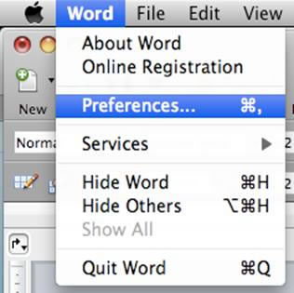
Menus
Choice of operations or services offered on the screen
Required option selected with pointer
The Interaction

Slide 22
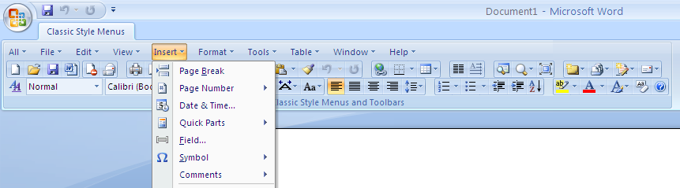
Menus
Menu Bar at top of screen (normally), menu drags down
Pull-down menu -Drags down on mouse click
Fall-down menus - Mouse just moves over bar
The Interaction

Slide 23
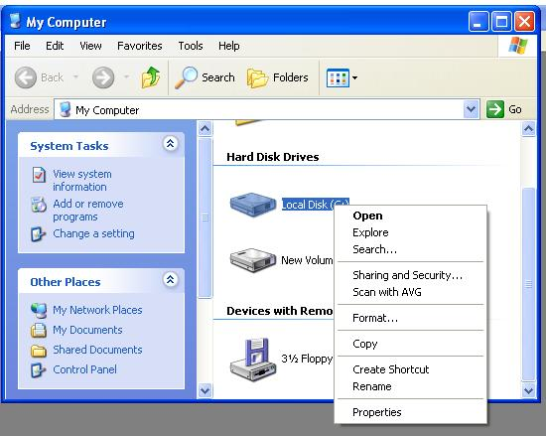
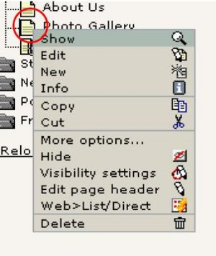
Menus
Pin-up menus – ‘Pinned’ to the screen, hides when asked
Pop-up menus
  Contextual menu
  Hidden – Pops up on request
The Interaction

Slide 24
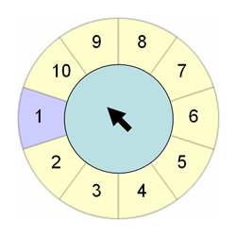
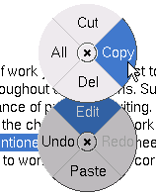
Menus
Pie menus
  Arranged in a circle
  Easier to select item (larger target area)
  Quicker (same distance to any option)
  Take up more screen space – Not widely used!
The Interaction

Slide 25
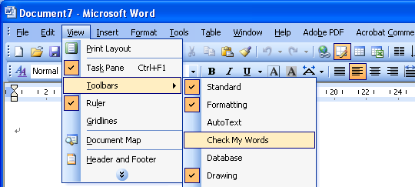
Menus
Cascading menus
  Hierarchical menu structure
  Menu selection opens new menu
The Interaction

Slide 26
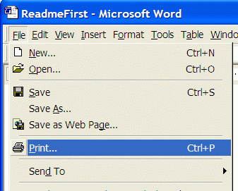
Menus
Keyboard accelerators
  Key combinations - same effect as menu item
  Two types
    Active when menu open – usually first letter
    Active when menu closed – usually Ctrl + letter
The Interaction

Slide 27
Menu Design Issues
What to include in menus at all?
How to group items?
Order
  Frequency and importance
  Opposite functionalities
Choice of keyboard accelerators
The Interaction

Slide 28
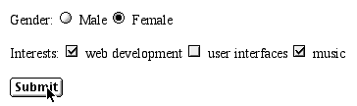
Buttons
Individual and isolated regions within a display that can be selected to invoke an action
Resemble ‘push buttons’
Toggle buttons
  Radio buttons
  – set of mutually exclusive choices
  Check boxes
  – set of non-exclusive choices
The Interaction

Slide 29
Toolbars
Long lines of icons
Fast access to common actions
Often customizable
  Choose which toolbars to see
  Choose what options are on it
The Interaction

Slide 30
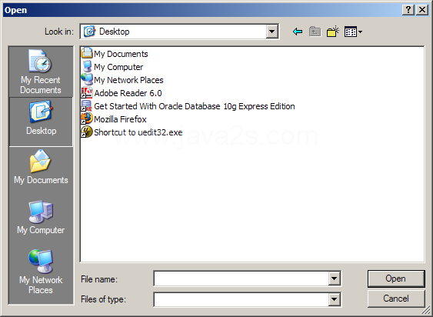
Dialog Boxes
Information windows that pop up to inform of an important event or request information.
E.g. Save file Dialog box
  Specify the filename and location
  Disappears once the file is saved
The Interaction

Slide 31
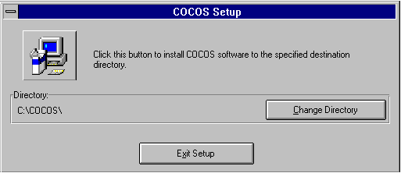
Interaction Styles - Usability
An installation program
The Interaction

Slide 32
Interaction Styles - Usability
Change of interaction style
Text Based Menu
This program will install COCOS software in directory C:\COCOS.
Type:
1 - to install COCOS
2 - to change directory
3 - to exit without installation
Your choice: __
Is it clear what and how to do?
The Interaction

Slide 33
Interaction Styles - Usability
Usability is affected by
  Directness - Can users perform all operations they need? Can they perform them in a concise, natural way?
  Flexibility - Can users easily perform any reasonable operation at any time?
  Visibility - Can users see the actions they can perform? Is it clear which operations will be done by each action?
  Consistency - Can users predict application's behavior, based on uniform screen design, similar representation of the similar operations, etc.?
The Interaction

Slide 34
Contents
Introduction
Models of Interaction
Ergonomics
Interaction Styles
Interactivity
Experience, Engagement & Fun
The Interaction

Slide 35
Interactivity
Defining feature of interactive system
Speech driven interfaces
  Rapidly improving
  Still inaccurate
  Speech based: Input is Difficult, Interaction is Easier
  Yes/No Response – Reliable
  System reflects back its understanding
  E.g. Air line reservation
    “you want a ticket from New York to Boston?”
The Interaction

Slide 36
Interactivity
Error and Repair
Can’t always avoid errors …
Make it easy to detect errors
  …And then repair them
Sys: Hello, this is the Go Faster booking system. What would you like?
User: I want to fly from New York to London
Sys: You want a ticket from New York to Boston
User: no
Sys: Sorry, please confirm one at a time
Sys: Do you want to fly from New York
User: yes
… … …
The Interaction

Slide 37
Contents
Introduction
Models of Interaction
Ergonomics
Interaction Styles
Interactivity
Experience, Engagement & Fun
The Interaction

Slide 38


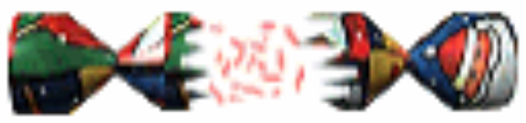

The Interaction

Slide 39
What is important in HCI
Usability
Effectiveness
Efficiency
Satisfaction
People are going to work better if they enjoy what they are doing
The Interaction

Slide 40

User Experience
Example – Shopping
  Internet stores
  Going to shops, feeling the clothes, being with friends
  Go shopping without spending
  Shopping
    Not an efficient financial transaction
    It’s an experience
The Interaction

Slide 41


Psychology of Experience
Flow – Total Engagement
  Doing something you know how to do?
  Edge of your abilities - beyond your limits
  Example: Rock Climbing
Education
  Zone of proximal development
  Things you can do with some support (teacher, book etc.)
  Learning at its best in this zone
Reading Assignment
The Interaction

Slide 42
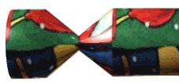
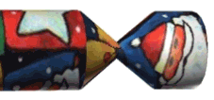

Designing Experience (Simulation)
Real Christmas crackers
  Cheap and cheerful!
  Joke, plastic toy, paper hat
  Pull and bang
The Interaction

Slide 43
Designing Experience (Simulation)
Virtual crackers
  Cheap and cheerful!
  Joke, web toy, cut-out mask
  Click and bang
The Interaction

Slide 44

Designing Experience (Simulation)
Virtual crackers
  Cheap and cheerful!
  Joke, web toy, cut-out mask
  Click and bang
The Interaction

Slide 45





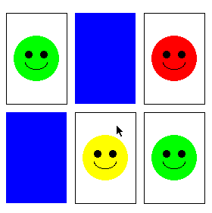
How crackers work
fill in web form
sender
To: wxv
From: ..
receive email
recipient
closed
cracker page
open
message
watches
progress
recipient clicks
cracker opens ...
very slowly
open
cracker page
joke
links
sender
mask
web toy
The Interaction

Slide 46
Physical Design
Design constraints
  Ergonomic – minimum button size
  Physical – high-voltage switches are big
  Safety – high cooker controls
  Context and environment – easy to clean
  Aesthetic – must look good
  Economic – … and not cost too much!
Constraints may be self contradicting
  Front Vs Back control for a cooking range
The Interaction

Slide 47
Managing Value
If you want people to use your device/application
  Understand their value
People use something
ONLY IF
it has perceived value
AND
value exceeds cost
The Interaction

Slide 48
Managing Value
Value
  Helps me get my work done
  Faster
  Enjoyment (may not be calculated)
Cost
  Download time
  Money £, $, €
  Learning effort
The Interaction

Slide 49
General Lesson
If you want someone to do something …
Make it easy for them!
Understand their values
The Interaction

Slide 50

References
Chapter 3 - Human Computer Interaction by Dix et al.
User Interface Hall of Fame/Shame
The Interaction

